Slide 1



VAST EXPANSE
COS 301
DEMO 4
LINK

Slide 2
IN THIS DEMO
Deployment Diagram
Automated Tests
Overview
Live Demo
Q & A
Smart AND Awesome

Slide 3
CORE OVERVIEW
Physical Access
Company
Visitor Packages
Employee
Smart Payments
Business Cards
Client
Wi-Fi Access

Slide 4
SOFTWARE OVERVIEW
Link Mobile
For employees and clients
Link Desktop
For company representatives
Sharing and receiving cards and packages
Managing company specific data

Slide 5
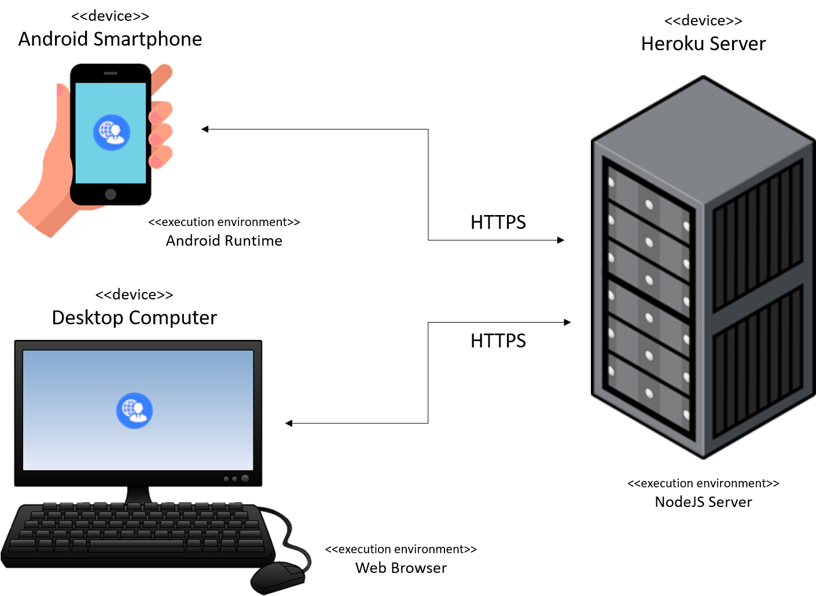
DEPLOYMENT DIAGRAM

Slide 6






AWESOME ASPECTS
Companies can manage all their data through one simple and reliable web interface.
Networking between future clients and employees is fast and simple, thanks to NFC.
Virtual business cards are automatically created for employees of companies.
Clients can connect to Wi-Fi with one click - and tap their phones to gain physical access.
We have full Google Maps integration, navigating clients directly to any of your offices.
Hosting clients at your office is a piece of cake (said cake can also be bought using Link).

Slide 7


Slide 8
COMPUTER SCIENCE KNOWLEDGE
Object Relational Database Design
Web API Security
Progressive Web App Dev
Design Patterns
Good Software Principles
Human Computer Interaction
Efficient Data Structures

Slide 9
STILL TO COME
Enhance Security
Employee Bulk Add
Admin UI Upgrade
Forgot Password
Anything Improvable

Slide 10




UNIT AND INTEGRATION TESTS

Slide 11
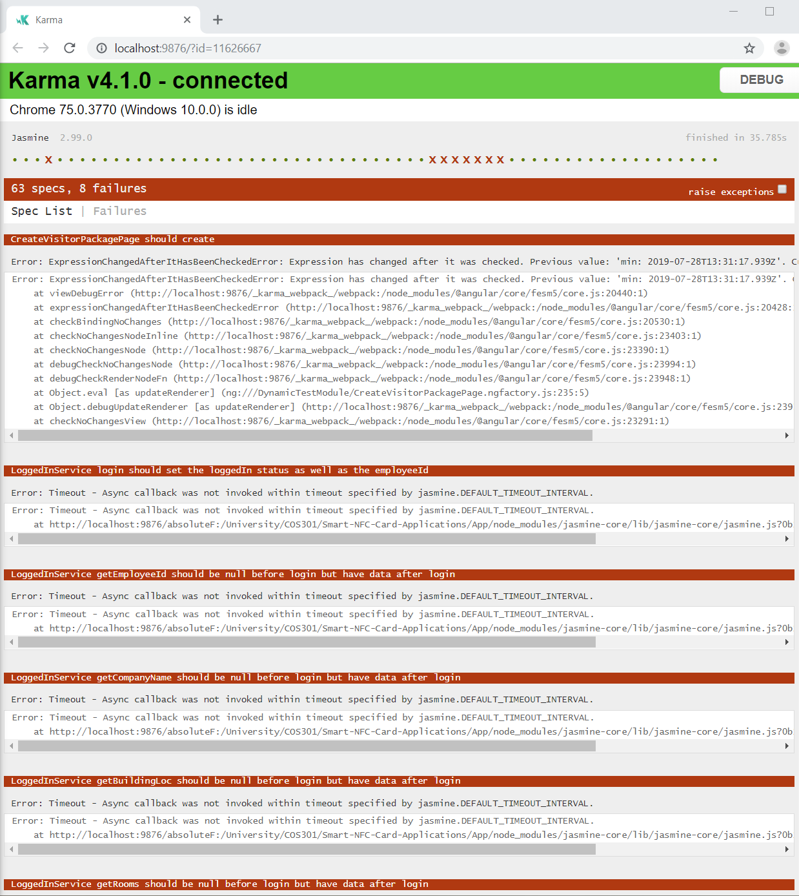
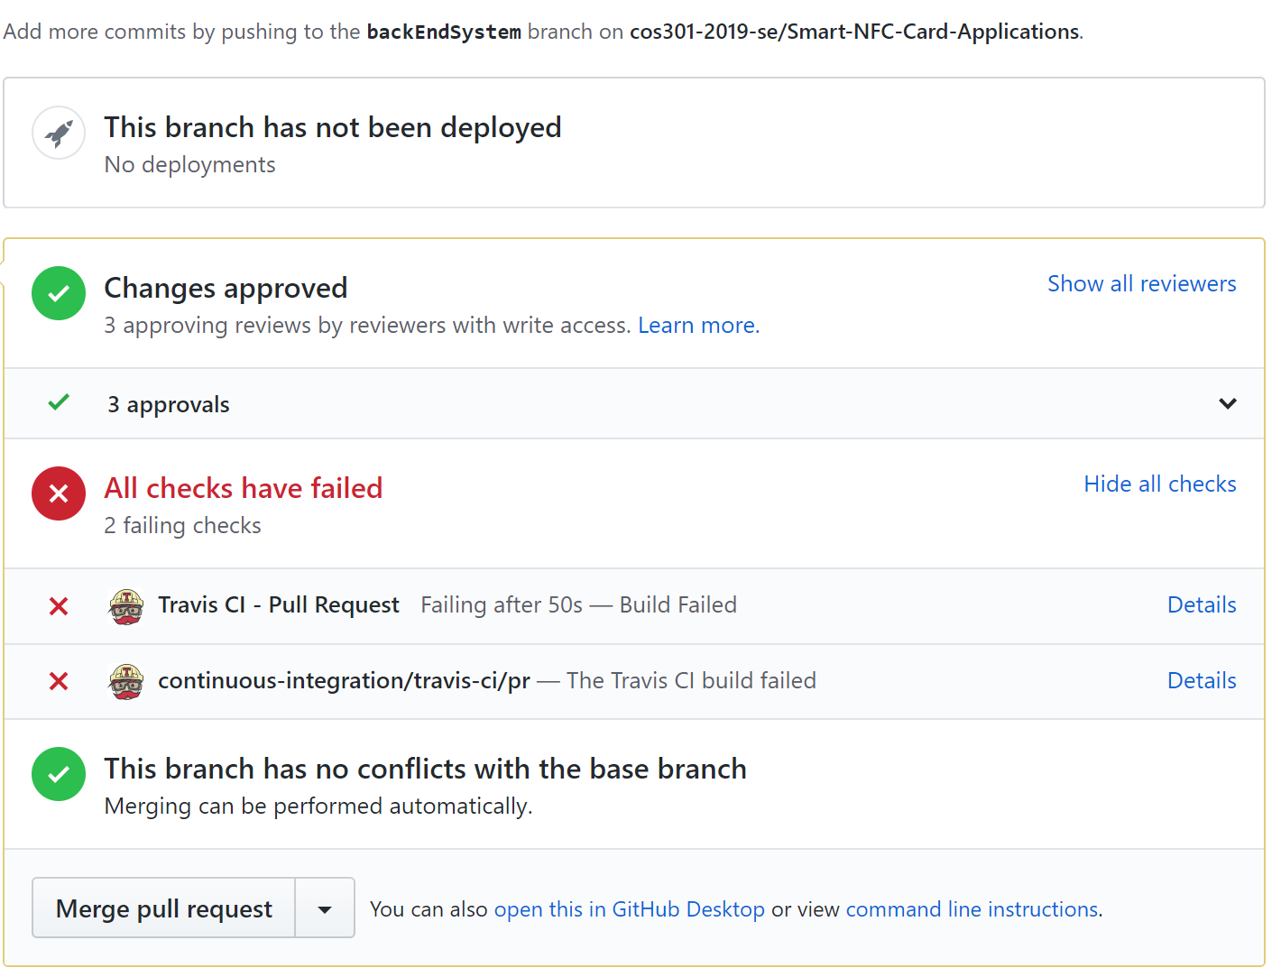
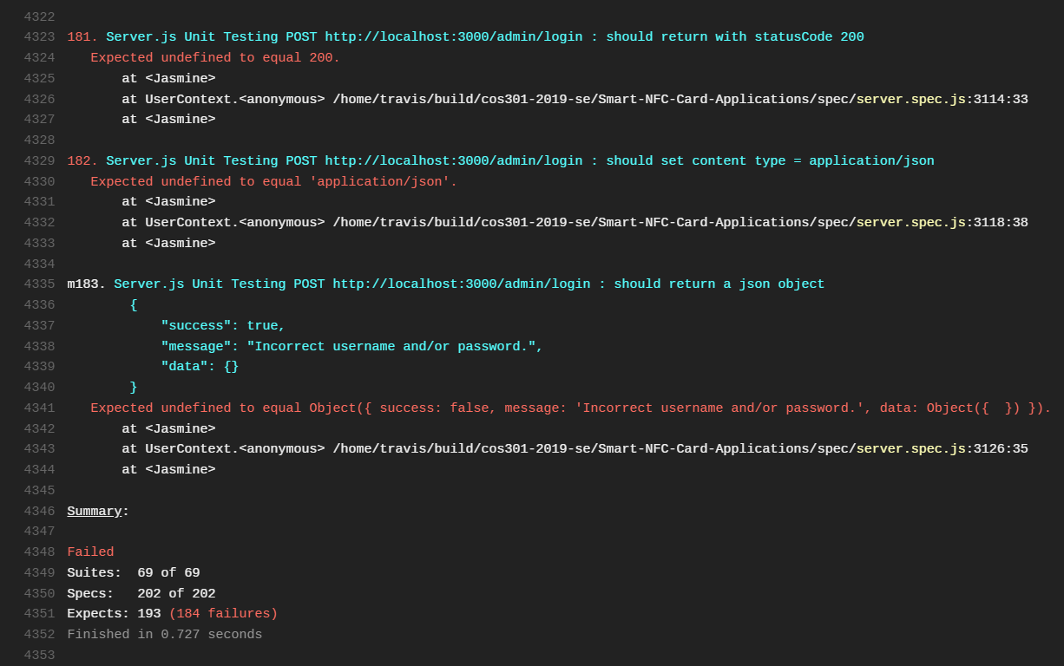
UNIT AND INTEGRATION TESTS
Not always sunshine and rainbows!

Slide 12

IT ALL STARTED ON A GOLF COURSE

Slide 13
THANK YOU

